Slide 1
Top 3 Careers
By AShley Ferguson
5th hour

Slide 2
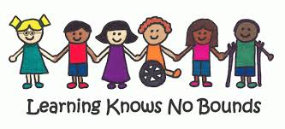
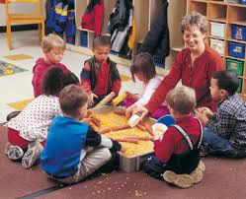
Special Education Teacher
The special education teacher plans and provides for appropriate learning experiences for students with disabilities in a variety of educational settings. The person in this position is responsible for creating a flexible program and learning environment that provides specialized instruction for students with disabilities, such that the students benefit from the general education curriculum to the greatest extent possible when supported with supplemental aides, accommodations, and other needed supports. The reason I would like to become a special needs teacher is I love children and most children like me, I like to babysit my cousins all the time and they love it too. I like to play outdoors, do arts and crafts and teach them good life lessons. I also like working with the students currently in school.

Slide 3
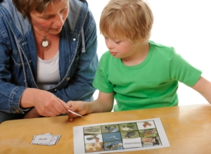
Special Education Teacher ( 10 characteristics )
Values- This career tests your patience a lot and it is also very overwhelming.
Tasks and responsibilities- Grading papers, making lesson plans for each day,helping students one on one.
Working with data-people-things - Using data would be using the internet and videos to showcase whatever they're learning. I would be working with students as well as their parents and my co workers. Things would be computers and books and school supplies.
Work environment- Many of the other teachers encourage and inspire you to keep moving forward and the children's faces will make me wanting to come to work each morning.
Working hours- Average school day is about 8 hours but teachers come before and stay after to prep for the following day but even when teachers get home then continue to grade papers and put lessons together.
Aptitudes and abilities- Special needs teachers must be able to adopt and know how to control certain situations and also get educated on different diagnostics and medications children could possibly be on.
Education and training- They must have a bachelor's degree at least and also a state license to work in public schools.
Salary and benefits- The median annual wage for special education teachers was $55,980 as of May 2014.

Slide 4
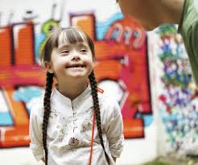
Special Education Teacher ( 10 characteristics )
Career outlook- Employment growth will also depend on government funding, since laws require free public education for students with disabilities. Every state must maintain the same level of financial support for special education every year.
International career outlook- Opportunities will vary by region and school setting. There will be better opportunities in urban and rural school districts than in suburban school districts.

Slide 5
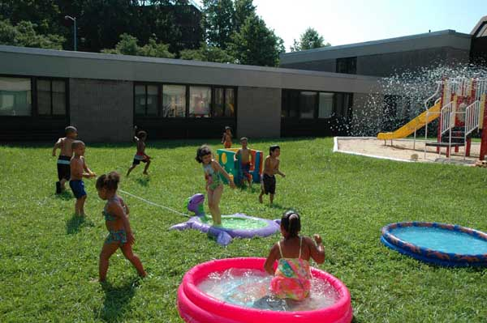
Lifestyle Goals
With everything that I learned about being a Special education teacher I would still live the life I wanted to live because I would still have holidays off so I can spend it with my family and I also could have the whole summer to take vacations and possibly gain another job in the summer.

Slide 6
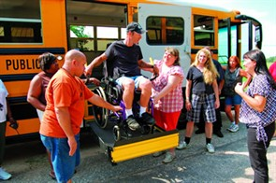
Location Career clusters
Special Education teachers can get a job anywhere. I honestly would try to get a job close to wherever I leave at that time or If that doesn't work out I would try to teach in a wealthy neighborhood that pays teachers more.
Educating and training

Slide 7
BAKERY OWNER
The reason why I want to own my own bakery is because I love making cakes and other desserts. For almost every holiday and birthday party, me and my aunt make cakes, everyone loves them and says they taste delicious.
Job Description
Prepares breads, rolls, muffins, cookies, pies, cakes, doughnuts, biscuits, and other pastries, including icings and frostings, according to established recipes.
Reviews production schedules to determine variety and quantity of goods to bake and to assemble supplies and equipment needed for daily baking activities.
Receives ingredients and other supplies from main kitchen and/or pantry as required for daily operations.
Cuts and weighs dough into uniform portions with knife or divider, molds dough into loaves or other shapes, and places in pans; proofs dough and bakes in oven using peel; inspects product for quality during and after baking and makes adjustments to processes as required.
Spreads or sprinkles a range of various toppings on specialty baked items.
Shapes dough for cookies, pies, and fancy pastries either by hand or by using dough rollers and cookie cutters.
Prepares compotes, gelatins, custards, meat pies, fillings, and other finishes as required.
Cleans and maintains work areas, utensils, and equipment.
Attends to day-to-day problems and needs concerning equipment and food supplies; detects and ensures disposition of spoiled or unattractive food, defective supplies/equipment, and/or other unusual conditions.
Completes production sheets and other records as required.
May be required to prepare baked goods for special diets.
Performs miscellaneous job-related duties as assigned.

Slide 8
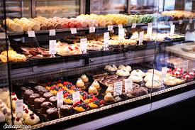
Bakery owner (10 characteristics)
Values- You must be passionate, Flexible, open minded and be able to prioritize and also be able to maintain a positive attitude.
Tasks and responsibilities- You must prepare an entire day's worth of desserts/products sold at the bakery and come up with ways to promote the bakery and also come up with new recipes.
Working with data, people,things- You must be able to research new recipes and have great communication skills with your customers to get them to want to come back and also must know how to use all of the equipment that is used in bakeries like oven, mixer, dough machine, food processor, etc...
Work environment- Working in a bakery usually means working as part of a team producing baked products. You may work with a small team in a craft bakery, or with a larger team in a factory or cafeteria. You may also work with staff who do other jobs in cafes, restaurants and hotels. Bakers may be required to work alone at times, for example when decorating cakes. Many smaller bakeries require their bakery staff to serve customers and mentor apprentices, or take on administrative/managerial roles.
Working hours- Most bakeries open early like at 7am but some employees get there 2-3 hours earlier to prepare for the day, then bakeries normally close at 5. Many bakeries have a flexible schedule.
Aptitudes and abilities- Bakery owners must good hand-eye coordination,good organisational skills, the ability to read and follow recipes, to be creative, the ability to follow strict health and safety standards, good health with no skin or breathing complaints, the ability to meet strict deadlines, to maintain a neat and clean appearance.

Slide 9
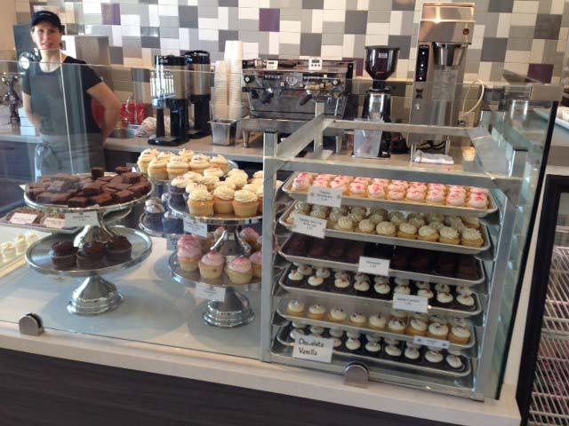
Bakery owner (10 characteristics)
Education and training- Although no formal education is required to become a baker, some candidates attend a technical or culinary school. Programs generally last from 1 to 2 years and cover nutrition, food safety, and basic math. To enter these programs, candidates may be required to have a high school diploma or equivalent.
Salary and benefits- The average salary for a bakery owner is $46,000. Average bakery owner salaries can vary greatly due to company, location, industry, experience and benefits.
Career outlook- Employment of bakers is projected to grow 7 percent from 2014 to 2024, about as fast as the average for all occupations. Baker’s with years of experience should have the best job opportunities, with employment driven by the growing demand for specialty baked products.
International career outlook- Highly skilled bakers with years of experience should have the best job opportunities.

Slide 10
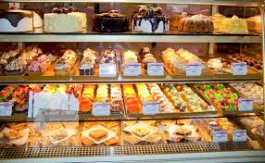
Lifestyle Goals
In Conclusion, With researching everything that I need to know about being a bakery owner I think this would be a great fit for me because I love making awesome cakes and everyone says that they are delicious and me and my aunt have plans in the future to own a bakery.

Slide 11
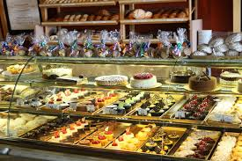
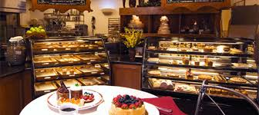
Location
Career cluster
Hospitality and Tourism
Owning my own bakery means that I buy a bakery or have one built at anyplace in the world. I will try to find one semi close to my house.

Slide 12
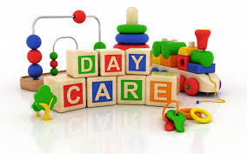
OWNER OF A DAYCARE
The job description of a child care center director is similar to that of any school administrator. However, child care center directors mainly oversee facilities that house younger children. They work in preschools, nursery schools, daycare centers, pre-kindergarten programs, group homes and, in some cases, school systems to oversee and coordinate child care and educational programs.
One of the main reasons I would love to own my own daycare would be because I love children and I want to do what I love for a career rather than just doing it for the money.

Slide 13
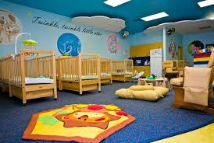
Owner of a daycare (10 characteristics)
Values- Teamwork, accountability, leadership and diversity
Tasks and responsibilities- come up with activities to entertain the children and make sure each individual child's needs are meet.Also the Child care center directors are responsible for setting the tone for the facility, managing the curriculum, overseeing physical facilities, hiring staff and managing the overall image of the center.
Working with things, data, people- owners of daycares work online to gather information on different activities for the kids to do and the owners also work with not only the kids but also their parents/family
Working environment- Child Care workers care for children in childcare centers, their own home, or the homes of the children in their care. Many work full time, but part-time work and irregular hours are common.
Aptitudes and abilities- Organization,licensing,advertising because you need clients.
Education and training- High school diploma; some positions require an associate's or bachelor's degree, License and CDA often required; early childhood education experience usually necessary.
Salary and benefits- They make anywhere from $30-70,000 a year
Career outlook- Employment of child care workers is projected to grow 5 percent from 2014 to 2024, about as fast as the average for all occupations. Job opportunities for childcare workers are expected to be favorable.
International career outlook- People have kids all over the world and so they need daycares to watch there kids when thay are at work or wherever.

Slide 14
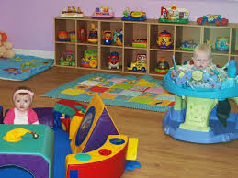
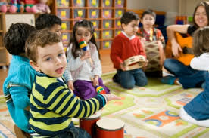
Owner of a daycare
Lifestyle
This fits into my lifestyle because I could hangout with my kids if I have any as well as others and I would hire employees so that I could just basically choose my schedule.

Slide 15
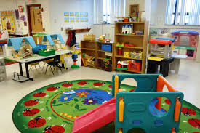
Owner of a daycare
Career cluster
Location
Owning my own daycare means that I buy a daycare building or have one built at anyplace in the world. I will try to find one semi close to my house.
Educating and training

