Slide 1
By: Ashley Ferguson

Slide 2
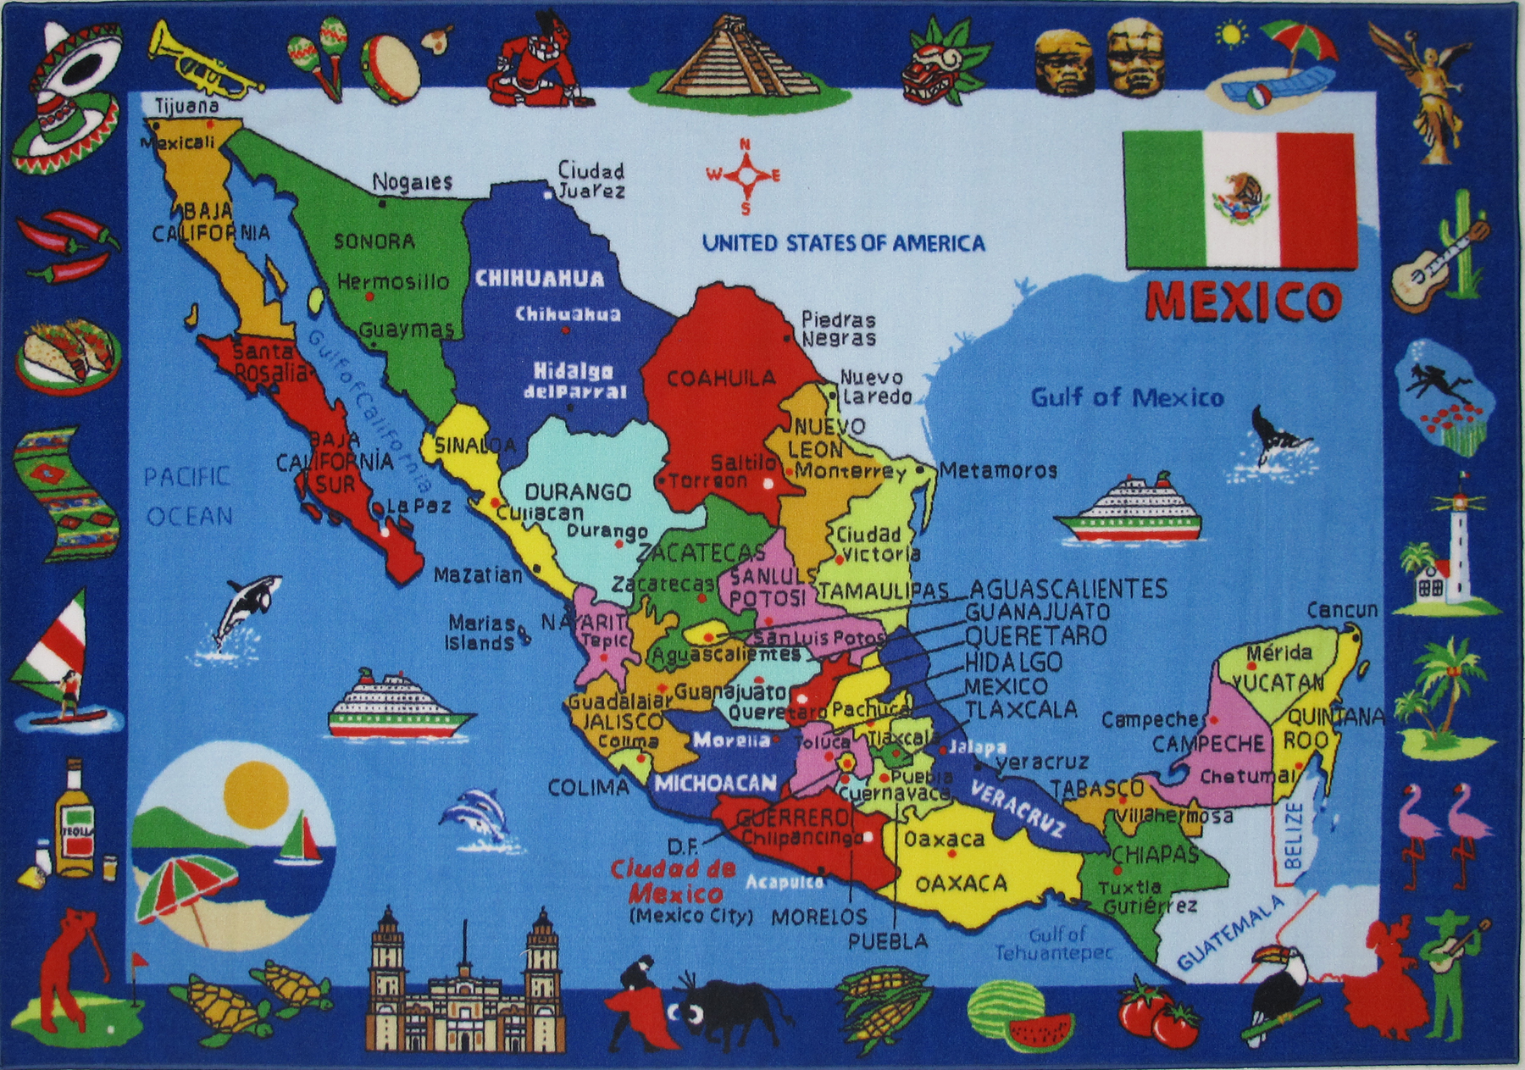

Slide 3
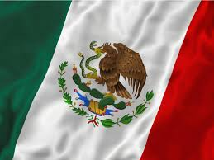
INFO
Located in the continent of North America, Mexico covers 1,943,945 square kilometers of land and 20,430 square kilometers of water, making it the 14th largest nation in the world with a total area of 1,964,375 square kilometers.
Mexico is run by a federal republic under a centralized government.
Mexico is a capitalist country.
Mexico is under a mixed economy but the government has a little more control over business.

Slide 4
Business greetings and attire:
If your natural tendency is to speak quickly or you have a forceful or sharp tone of voice, become aware of how you are coming across. Become sensitive to the pace and tone used in Mexico. Otherwise you will destroy a relationship with your caustic tone and behavior.
Business lunches, rather than dinners are the traditional form of business entertaining and are usually prolonged affairs, beginning between 2:00 and 3:00 p.m. and lasting three to four hours, with little time being devoted to actual business. Lunches are an essential part of business to establish a personal relationship.
Giving gifts to business executives is not required. Small items with a company logo (for an initial visit) are appreciated.
Women should not invite a male counterpart for a business dinner unless other associates or spouses attend. Also, Mexican men will graciously attempt to pay for a meal, even though you are hosting it. A professional way to host a meal is to dine or lunch at your hotel. Pre-arrange to have the meal added to your hotel bill.
Men should wear conservative, dark coloured suits.
Women should wear business suits or conservative dresses

Slide 5
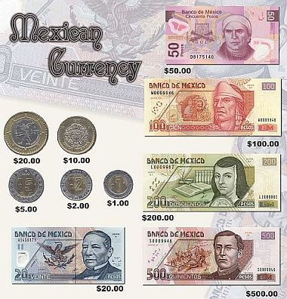
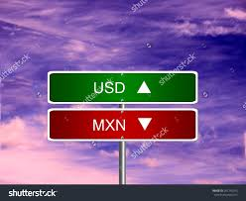
CURRENCY
0.0549193 USD =1 MEXICAN PESO
MEXICAN PESO

Slide 6
DO NOT’S IN MEXICO
DO NOT DRINK THE WATER IN PUBLIC
IN RESTAURANTS DO NOT LEAVE THE TABLE WITHOUT TIPPING
DO NOT SWIM IN THE SEA WHEN THE RED FLAG IS UP
DO NOT BASH WOMEN IN PUBLIC
IN A RESTAURANT NEVER SAY YOU DON'T LIKE MEXICAN FOOD OR TEQUILA
DO NOT URINATE IN PUBLIC
DO NOT YAWN IN PUBLIC
DO NOT SHOW UNDERGARMENTS IN PUBLIC

Slide 7
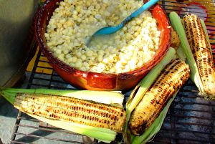
Food and table manner
The food in Mexico
TABLE MANNERS:
Mexican food continued evolving as new products and techniques were introduced into Mexico from different places. We can find recipes and ingredients originally from South America, the Caribbean and even Africa. Mexican food is all considered very spicy .
Always keep your hands visible when eating. Keep your wrists resting on the edge of the table. When you have finished eating, place your knife and fork across your plate with the prongs facing down and the handles facing to the right. Do not sit down until you are invited to and told where to sit. Do not begin eating until the hostess starts. Only men give toasts. It is polite to leave some food on your plate after a meal.

Slide 8
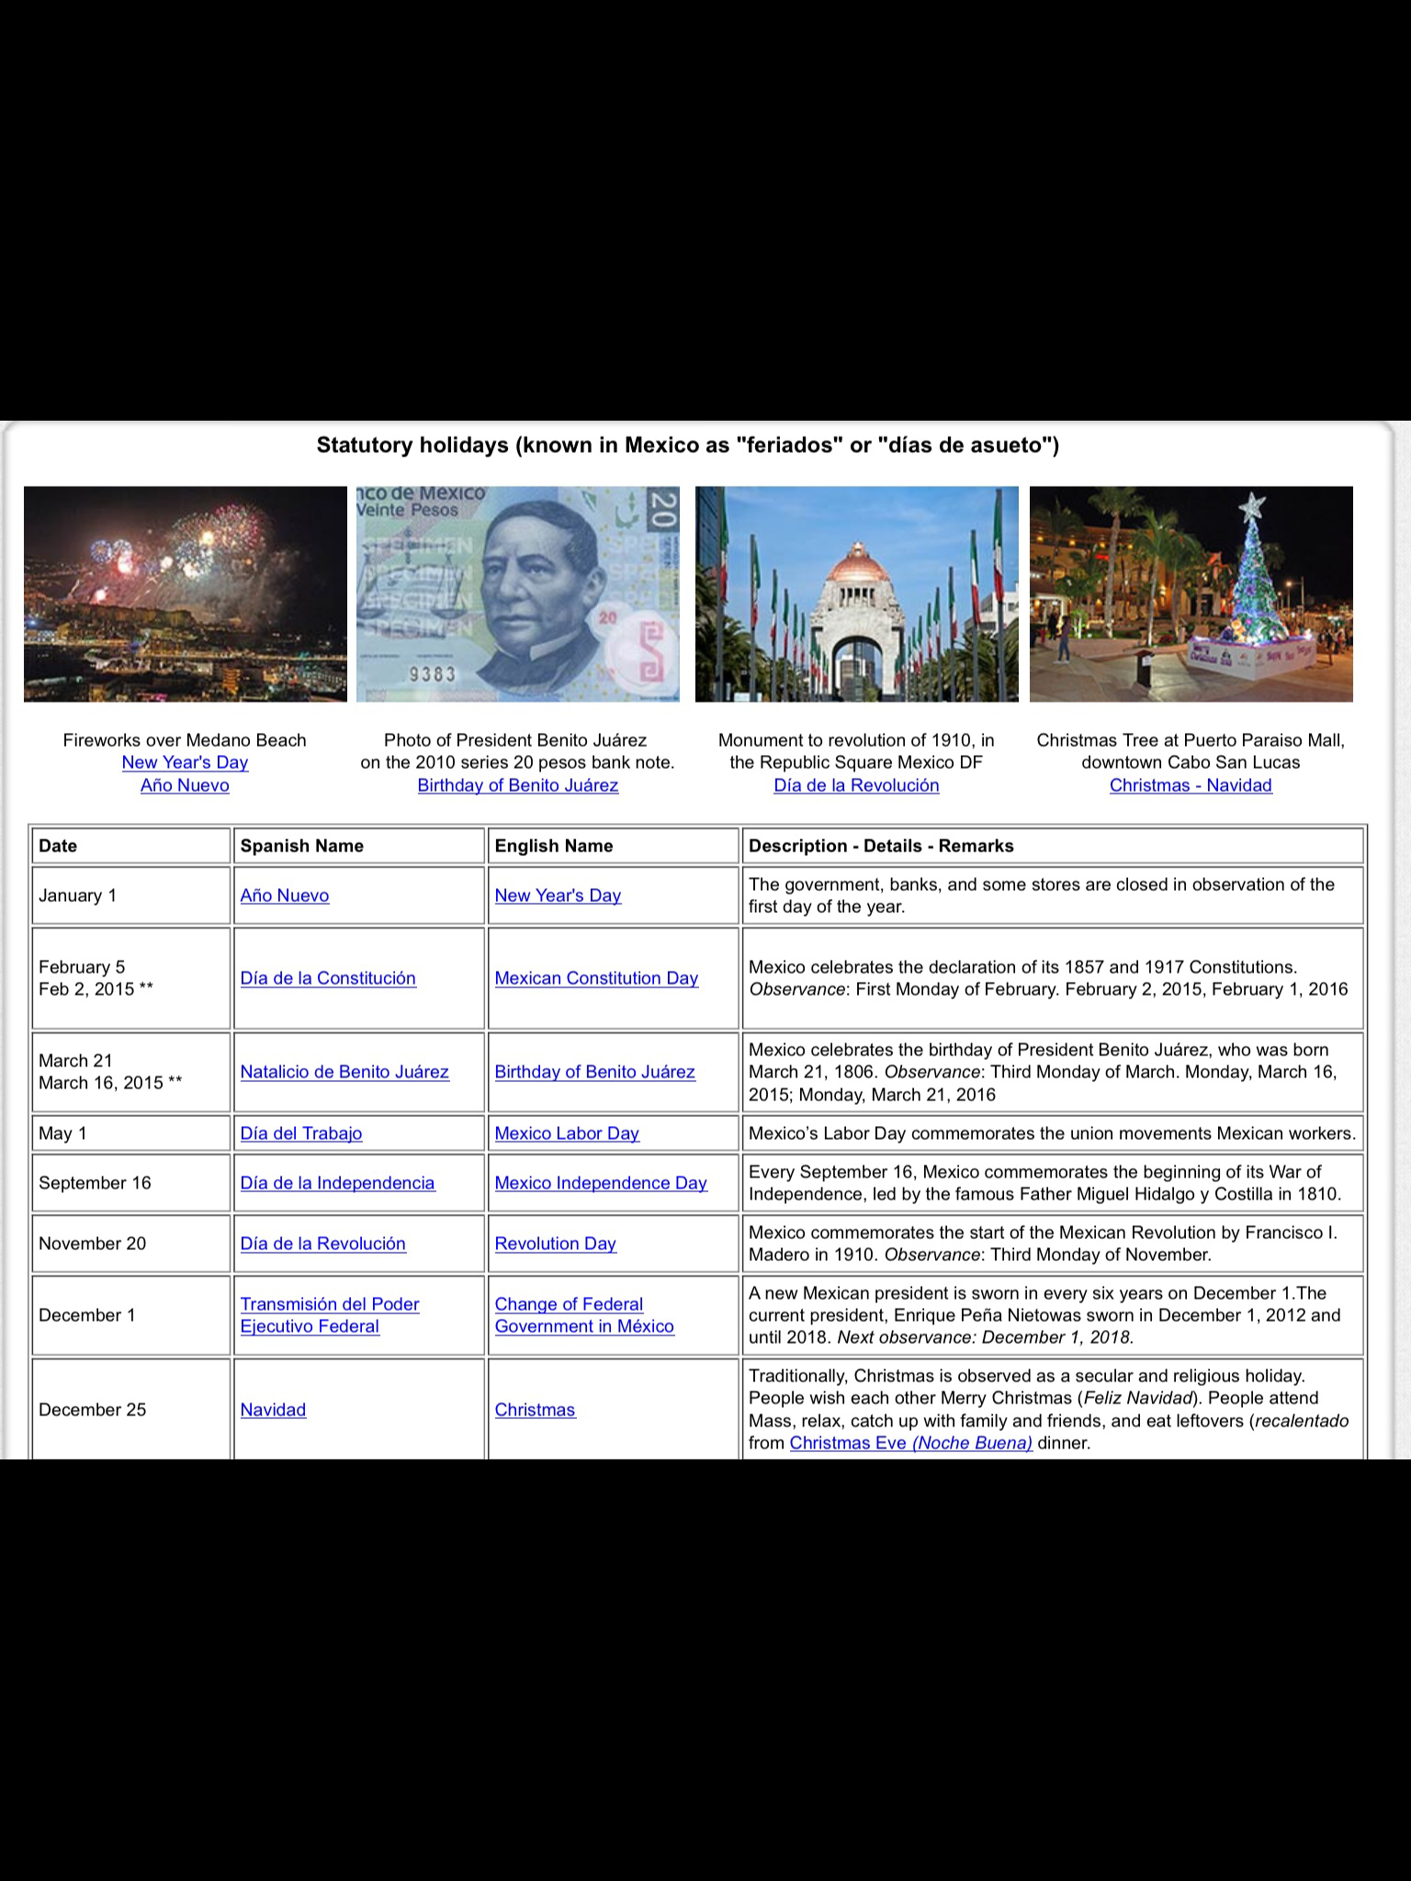
HOLIDAYS AND CELEBRATIONS

Slide 9
US legal system versus Mexico legal system
The U.S. common law system is based on the case law and statutory law of England and the American colonies before the American Revolution. As the name implies, the traditional common law system emphasizes case law, customs and usage rather than legislative enactments. In contrast, Mexico's civil law system is derived primarily from Roman law as set forth in the compilation of codes and statutes of the Emperor Justinian, called Corpus Juris Civilis, and later refined in the French or Napoleonic Code of 1804. Mexico's legal system is also influenced by colonial law (the Spanish and "Indian" law of Spain's colonization in the areas that became Mexico and other present day Latin American countries), which was a highly formal body of law, including specific collections of not only laws but customs or accepted legal practices, that required the use of intricate regulations and elaborate writings associated with every important act of one's life, such as birth or marriage, and canon law, or religious law, issued by the Catholic Church.

Slide 10
Languages and common phrases used in Mexico
The three most common languages spoken in Mexico is Spanish, English, and Nahuatl .

Slide 11
Hand gestures and body language
A warm, somewhat soft handshake is the customary greeting among both men and women. Men should let the woman make the first move toward handshaking. After the second or third meeting, Mexican men may begin with or add the abrazo, the embrace along with a few pats on the back. Women friends will embrace lightly and pretend to kiss a cheek. In some areas of Mexico, you may encounter an unusual addition to the handshake where, after gripping the palm, the two people slide their hands upward to grasp each other’s thumbs. Many Mexicans are ‘touch oriented.’ This means they may linger over a handshake, they may touch the forearm or elbow, or they may even casually finger the lapel of the other person’s suit. All these touches merely signify a willingness to be friendly nothing more. If a man stands with his hands on his hips, it suggests hostility. Deference is shown to the elderly, so give way to them in public and don’t object if they are waited on first. Never visit churches or religious sites while wearing shorts, tank tops, or cut-off shirts or shorts.

Slide 12
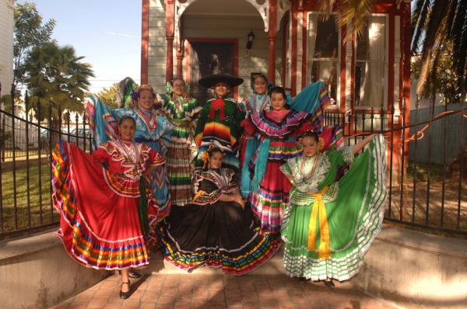
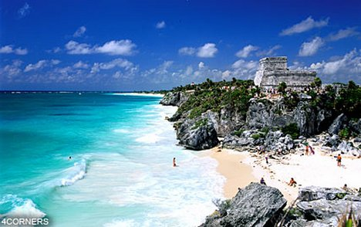
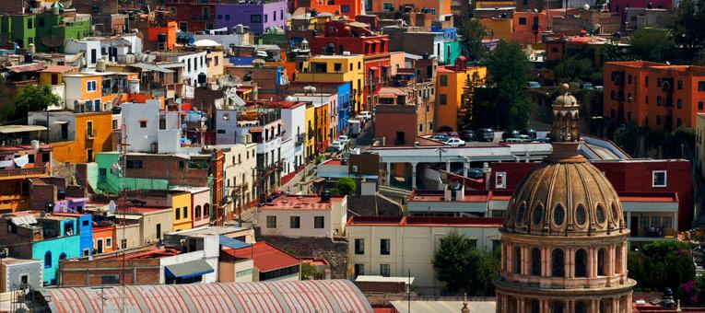
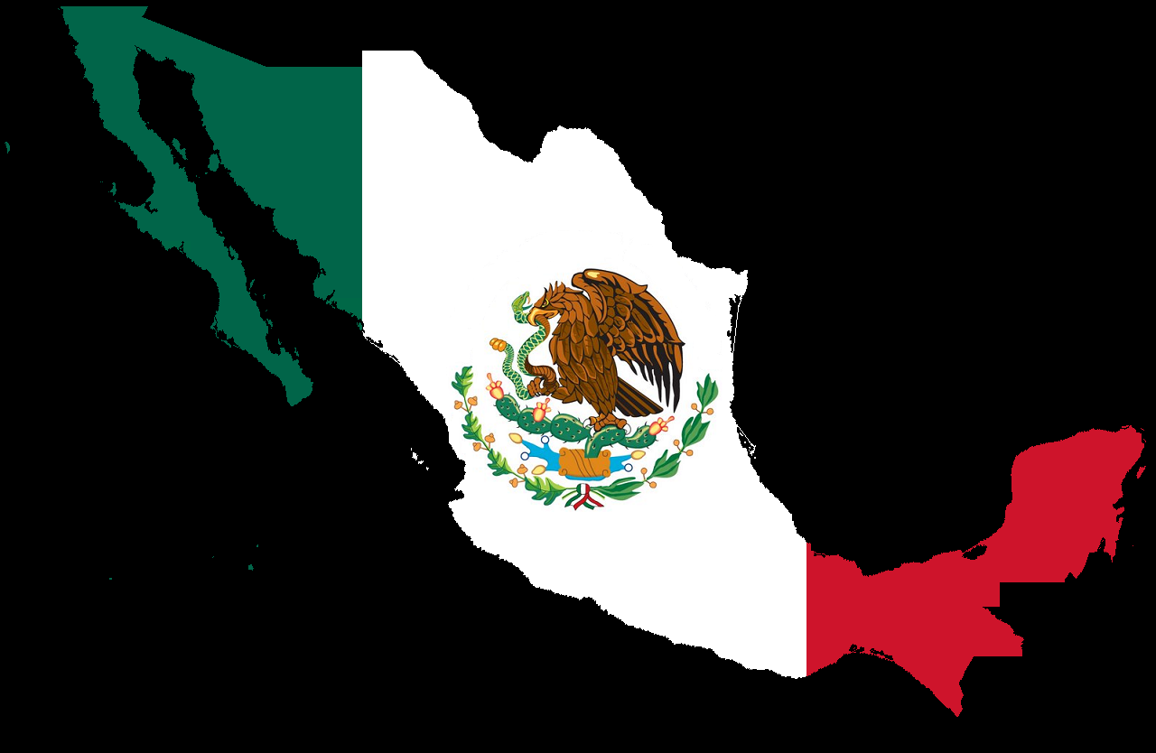

Slide 13
Etiquettescholar.com
Hispanic-marketing com
http://www.kwintessential.co.uk

